Slide 1
Apparisk
User interface
project management work flow

Slide 2
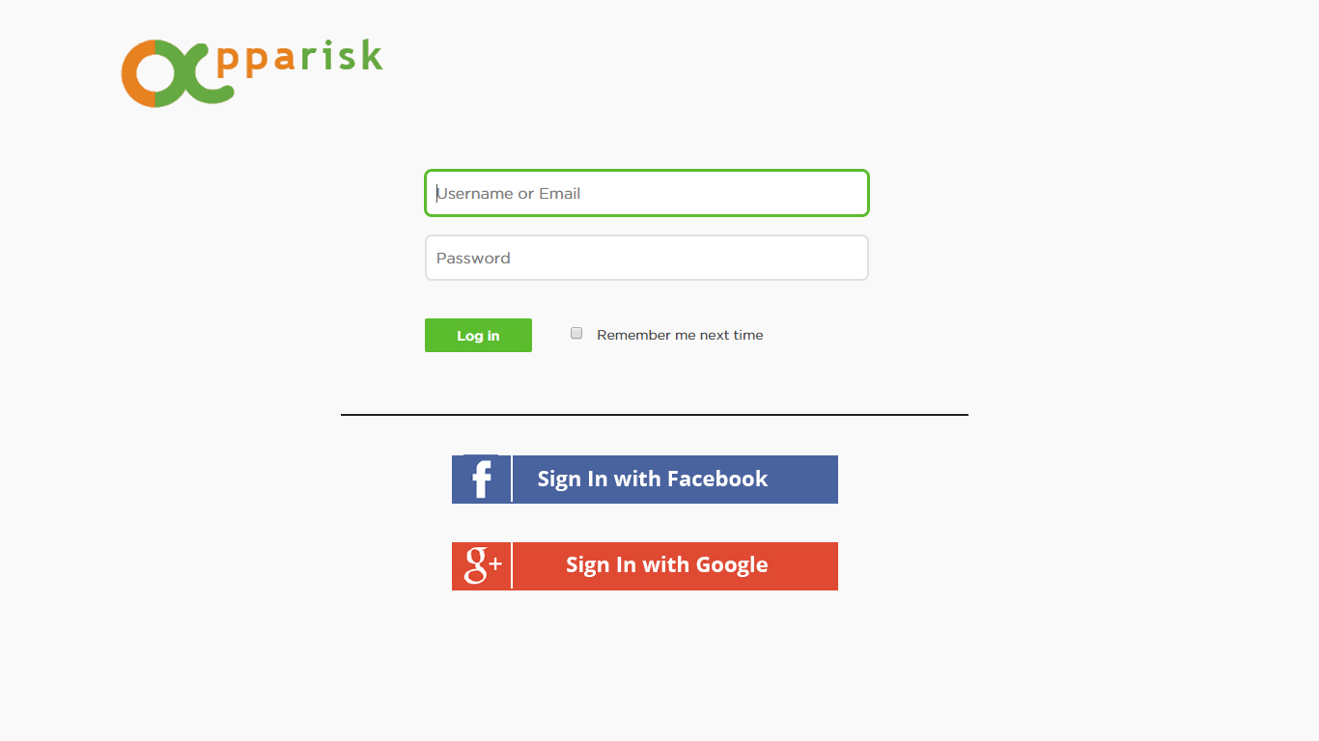
User can login using email or social media
If they don’t have any account, they need to register their company.

Slide 3
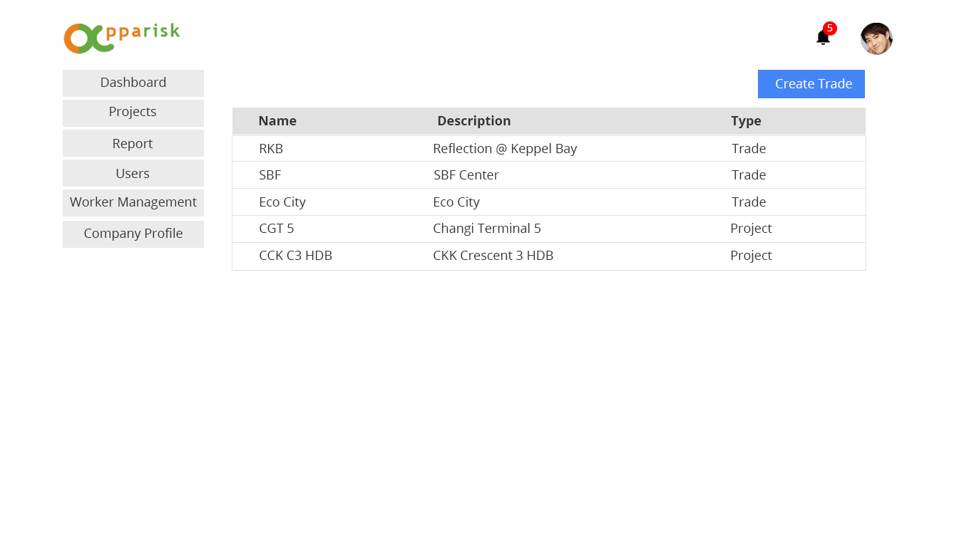
When they click on the project, all the project related to the user will be shown.
If user is company admin, they can see the all the menu.
But the user is company staff, they can see only dashboard, Projects and Reports.

Slide 4
When they click on the create trade, they will see the Trade Creation form

Slide 5
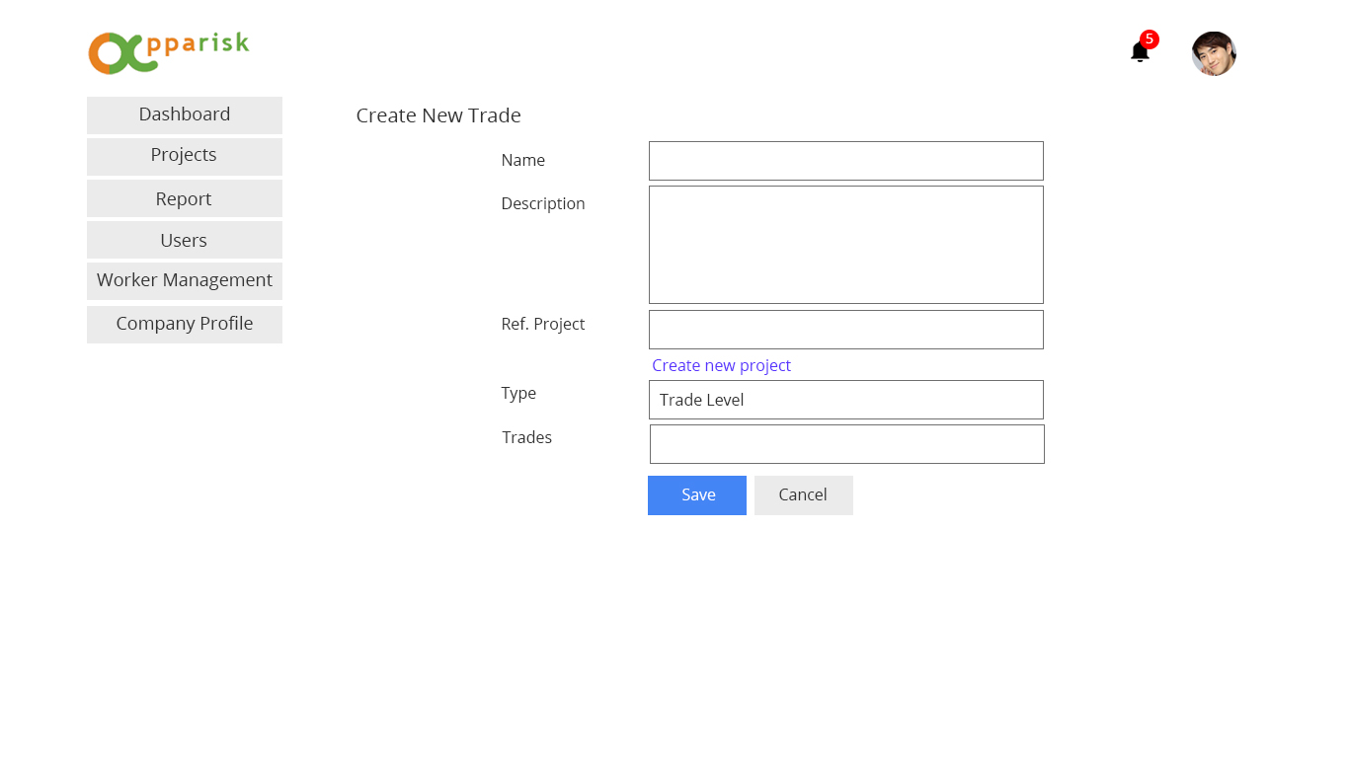
When they own the whole project and not the trade, they can change in Type to Project Level.

Slide 6
If they cannot find any related project for trade, they can create the new project.
This project information will be seen by all the apparisk user.

Slide 7
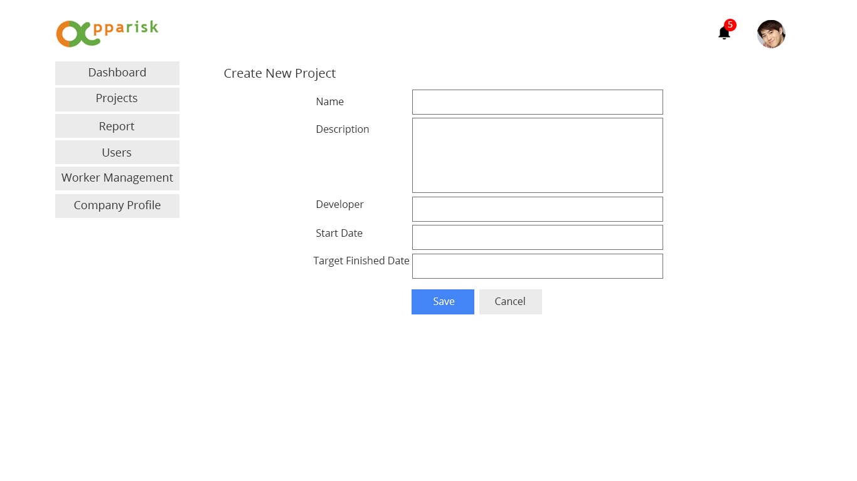
After they fill up all information, the system will redirect to the trade creation page.

Slide 8
After that they will fill up the trade details

Slide 9
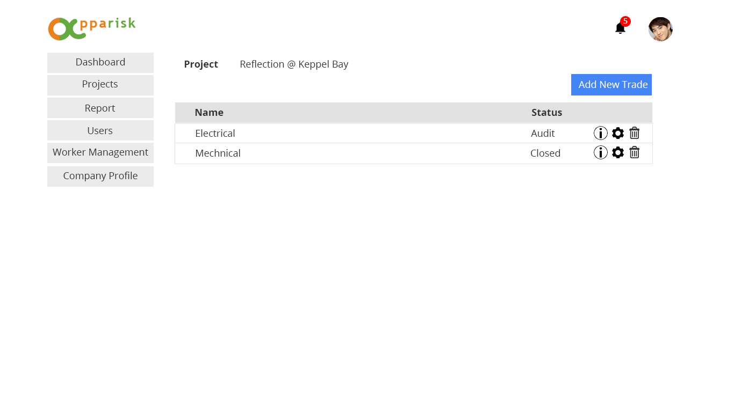
They can add the new trade.

Slide 10
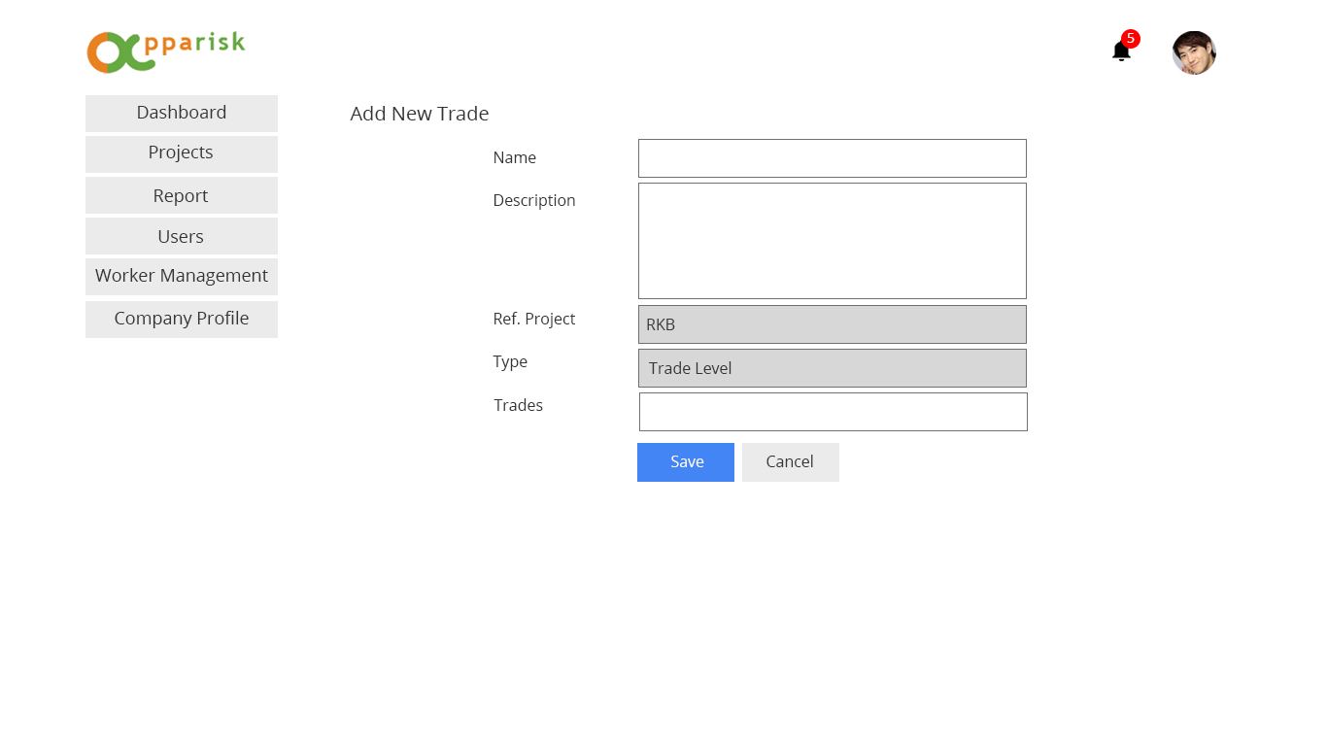
The ref project and type are aldy selected and user cannot change

Slide 11
When user click on the particular trade, they will see the detail of the trade

Slide 12
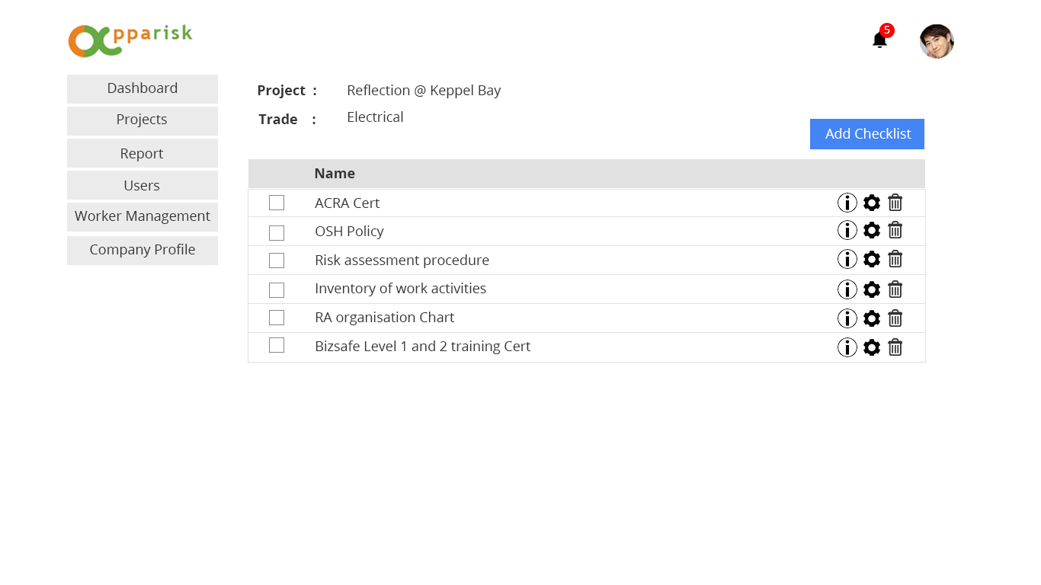
User can add/ delete the checklist
They also can assign other users

Slide 13
User click on the particular checklist item, it will go to checklist item detail pages.

Slide 14
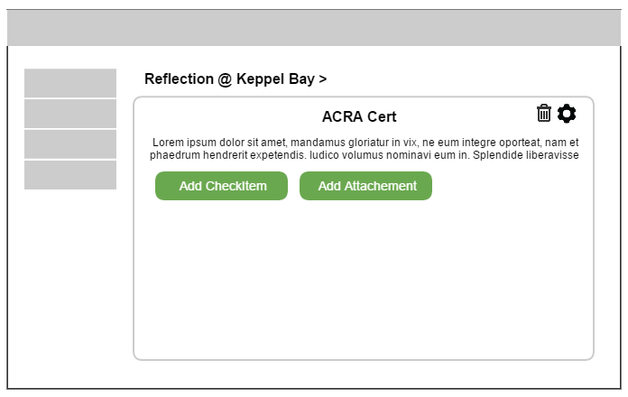
I will provide the new UI for this screenshot later.

